Slide 1

Green destinations
By-
Nissankara Rao Sushma

Slide 2
Project Statement
Green Destinations is a well-known travel agency. The HR Director has recently noticed an increase in employees leaving (attrition). She would like to figure out any trends or patterns. She has surveyed the staff of Green Destinations and provided you with the data. She would like to know what the attrition rate is (% of people who have left). She would also like to know if factors like age, years at the company and income play a part in determining if people will leave or not.

Slide 3
Objective
To analyze employee attrition data for Green Destinations in order to:
Calculate the overall attrition rate (percentage of employees who have left).
Identify key factors influencing attrition, such as:
  Age
  Years at the company
  Monthly income
Discover patterns or trends that can help the HR Director understand why employees leave and develop strategies to reduce attrition.

Slide 4
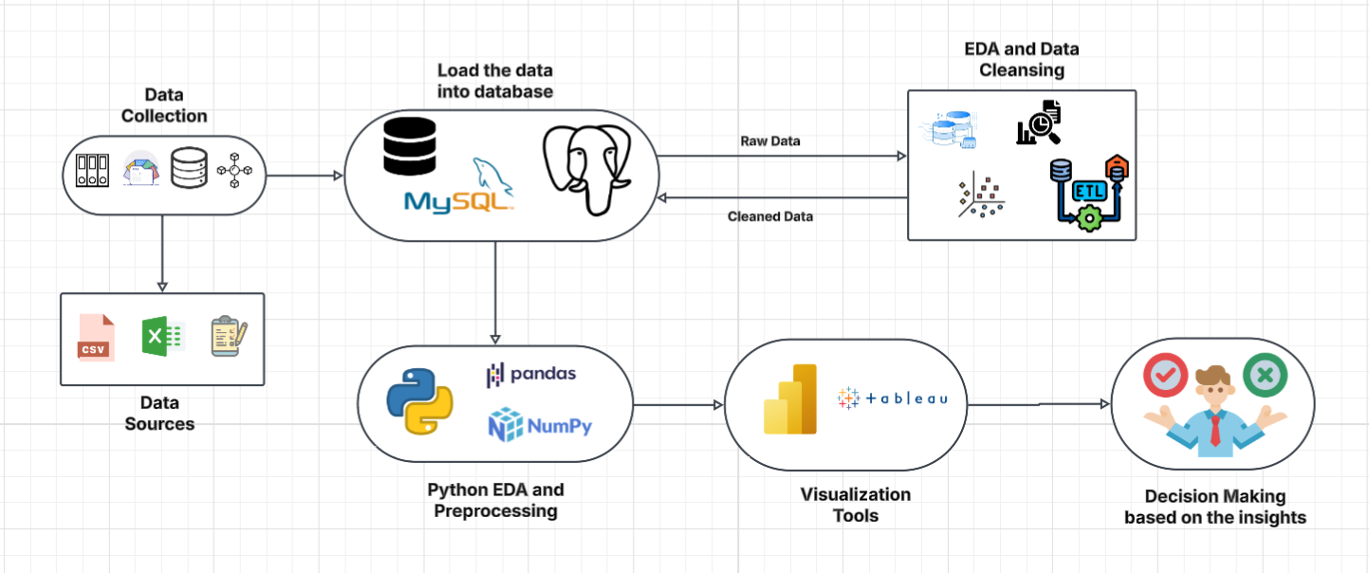
Project Architecture – Data Flow Diagram

Slide 5
Data dictionary
Column Name | Description
Age | Age of the employee
Gender | Gender of the employee
MaritalStatus | Marital status (Single, Married, Divorced)
Education | Education level (1 = Below College → 5 = Doctor)
EducationField | Field of study (Life Sciences, Technical, etc.)
DistanceFromHome | Distance between home and workplace
NumCompaniesWorked | Number of companies worked before
Over18 | Whether employee is over 18 years old
TotalWorkingYears | Total years of professional experience

Slide 6
Data dictionary
Column Name | Description
Department | Department name (Sales, R&D, HR)
JobRole | Role or designation
JobLevel | Job position level (1–5)
YearsAtCompany | Years worked in the company
YearsInCurrentRole | Years spent in the current role
YearsSinceLastPromotion | Years since last promotion
YearsWithCurrManager | Years with current manager
MonthlyIncome | Monthly salary
MonthlyRate | Monthly pay rate
DailyRate | Daily rate
HourlyRate | Hourly rate
StockOptionLevel | Stock option level (0–3)
PercentSalaryHike | % increase in salary
OverTime | Whether employee works overtime
BusinessTravel | Frequency of business travel

Slide 7
Data dictionary
Column Name | Description
Attrition | Whether employee has left (Yes / No)
EnvironmentSatisfaction | Satisfaction with work environment (1–4)
JobSatisfaction | Satisfaction with job (1–4)
RelationshipSatisfaction | Satisfaction with management/colleagues (1–4)
WorkLifeBalance | Work-life balance satisfaction (1–4)
JobInvolvement | Level of involvement in job (1–4)
PerformanceRating | Employee performance rating (1–4)
TrainingTimesLastYear | Number of trainings attended last year
StandardHours | Standard working hours (usually constant = 80)
EmployeeCount | Employee record count (constant = 1)
EmployeeNumber | Unique employee ID

Slide 8
Exploratory Data Analysis
Index | Mean | Variance | Std Dev | Skewness | Kurtosis
Age | 36.9238 | 83.455 | 9.13537 | 0.413286 | -0.404145
DailyRate | 802.486 | 162820 | 403.509 | -0.08351857 | -1.20382
DistanceFromHome | 9.19252 | 65.7213 | 8.10686 | 0.958118 | -0.224833
Education | 2.91293 | 1.04891 | 1.02416 | -0.289681 | -0.559115
EmployeeCount | 1 | 1.23343e-32 | 1.110e-16 | 0 | 0
EmployeeNumber | 1024.87 | 362433 | 602.024 | 0.016574 | -1.22318
EnvironmentSatisfaction | 2.72177 | 1.19483 | 1.09308 | -0.312654 | -1.128
HourlyRate | 65.8912 | 413.286 | 20.3294 | -0.032311 | -1.1964
JobInvolvement | 2.72993 | 0.506319 | 0.711561 | -0.498419 | 0.270999
JobLevel | 2.06395 | 1.22532 | 1.10694 | 1.0254 | 0.399152
JobSatisfaction | 2.72857 | 1.21627 | 1.10285 | -0.329672 | -1.22219

Slide 9
Exploratory Data Analysis
Index | Mean | Variance | Std Dev | Skewness | Kurtosis
MonthlyIncome | 6502.93 | 2.21649e+07 | 4707.96 | 1.36982 | 1.00523
MonthlyRate | 14313.1 | 5.06629e+07 | 7117.79 | 0.0185778 | -1.21496
NumCompaniesWorked | 2.6932 | 6.24005 | 2.49881 | 1.02647 | 0.0102138
PercentSalaryHike | 15.2095 | 13.3951 | 3.65994 | 0.821128 | -0.300598
PerformanceRating | 3.15374 | 0.130194 | 0.360824 | 1.92188 | 1.69594
RelationshipSatisfaction | 2.71224 | 1.16901 | 1.08121 | -0.302828 | -1.18481
StandardHours | 80 | 0 | 0 | 0 | 0
StockOptionLevel | 0.793878 | 0.726335 | 0.852077 | 0.96898 | 0.364634
TotalWorkingYears | 11.2796 | 60.5406 | 7.78578 | 1.11717 | 0.91827
TrainingTimesLastYear | 2.79932 | 1.66222 | 1.28927 | 0.553124 | 0.494993
WorkLifeBalance | 2.76122 | 0.499188 | 0.706476 | -0.55248 | 0.41946
YearsAtCompany | 7.08016 | 37.5343 | 6.12653 | 1.76453 | 3.93551
YearsInCurrentRole | 4.22925 | 13.1271 | 3.62314 | 0.917363 | 0.477421
YearsSinceLastPromotion | 2.18776 | 10.3841 | 3.22243 | 1.98429 | 3.61267
YearsWithCurrManager | 4.12313 | 12.7316 | 3.56814 | 0.833451 | 0.171058

Slide 10
Data preprocessing
Step | Function(s) | Purpose
Importing Libraries | import pandas as pd, import numpy as np, import seaborn as sns, import matplotlib.pyplot as plt, from sklearn.preprocessing import StandardScaler | To import all the necessary Python libraries for data manipulation, visualization, and preprocessing.
Loading Dataset | data = pd.read_csv("C:/Users/nrdev/Downloads/greendestination (1).csv") | To load the employee attrition dataset into a pandas DataFrame for analysis.
Checking Dataset Info | data.shape, data.columns, data.info() | To understand the dataset’s structure — number of rows, columns, and data types.
Checking Missing Values | data.isnull().sum() | To identify if any columns contain missing or null values.
Checking Duplicates | data.duplicated().sum() | To detect duplicate records in the dataset.
Outlier Detection | sns.boxplot() for numerical columns | To visualize and detect outliers in continuous variables such as Age, DailyRate, MonthlyIncome, etc.
Four Business Moments | mean(), var(), std(), skew(), kurt() | To calculate central tendency, dispersion, and shape statistics (Mean, Variance, Std. Dev, Skewness, Kurtosis).
Graphical Representation | sns.countplot(), sns.histplot(), sns.boxplot() | To visualize distributions and relationships — e.g., Age vs Attrition, Monthly Income vs Attrition.
Correlation Analysis | sns.heatmap(num_df.corr()) | To identify correlations between numerical variables and understand relationships among features.
Attrition Rate Calculation | data['Attrition'].value_counts(normalize=True).get('Yes', 0) * 100 | To calculate the percentage of employees who have left the company (Attrition Rate).

Slide 11
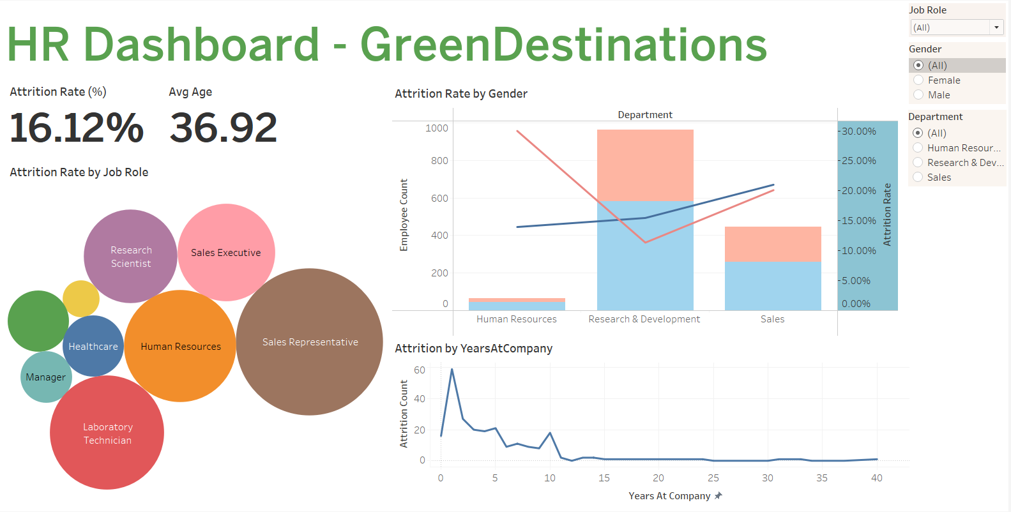
Data visualization

Slide 12
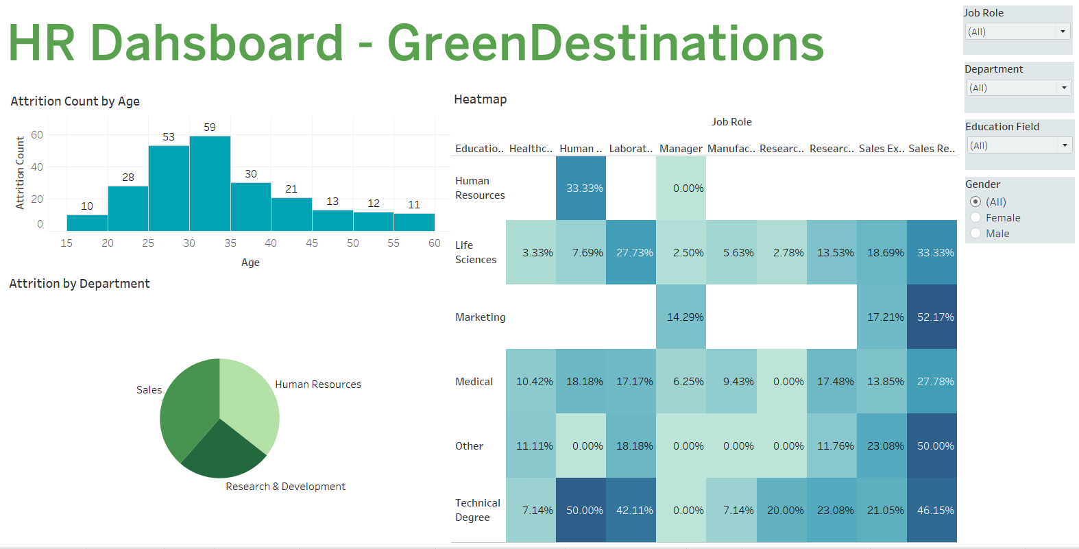
Data visualization

Slide 13
Key performance indicators
Overall attrition rate: 16.12%
Average employee age: 36.92 years
Highest attrition observed among.
Sales Representatives, Sales Executives, and Laboratory Technicians.
Managers and Healthcare professionals show the lowest attrition rates.
Employees aged 26–35 years have the highest attrition, suggesting mid-career turnover.
Female attrition rate is slightly higher compared to males.
Employees with Technical and Marketing degrees show the highest attrition percentages (up to 50%).
In Human Resources, attrition is high among employees with unrelated educational backgrounds.

Slide 14
Key takeaways
Early-stage employees (within 2 years) are most likely to leave — indicating a need to strengthen onboarding and retention programs.
Mid-career professionals (26–35 years) may be seeking career growth or better compensation.
Sales-related roles require focused engagement and performance incentives to reduce turnover.
Educational mismatch in certain roles may be contributing to higher attrition rates.

Slide 15
conclusion
In conclusion, the HR analysis for GreenDestinations highlights a moderate attrition rate of 16.12%, with the highest turnover observed among sales and technical roles, particularly within the first two years of employment. The findings emphasize the need for stronger onboarding, employee engagement, and targeted retention strategies, especially for mid-career professionals aged 26–35. Addressing factors such as role mismatch, limited growth opportunities, and workload imbalance can significantly improve retention. By fostering career development, inclusivity, and well-being initiatives, GreenDestinations can enhance employee satisfaction, reduce early attrition, and build a more motivated, stable, and high-performing workforce aligned with organizational goals.

Slide 16
The end

